Slide 1
Azure Fundamentals
Expectations?
Objectives
Norms:
Mobiles on silent mode
Lengthy topics/discussion to be handled offline
Please follow the instructions carefully

Slide 2
Agenda
Day 1 – Azure Infrastructure and Storage
Day 2 – Azure Data Factory
Day 3 – Azure Machine Learning Studio

Slide 3
Azure Platform – 30 min Azure platform, Active Directory
Introduction to Cloud
Services offered in Azure (IaaS, PaaS and SaaS)
Compute, Storage, Network
Azure resource group as container
Azure active directory (role management, App integration via SPID, RBAC)
Exercise
Create a resource group in SouthEast Asia: yourname_rg

Slide 4
Azure Storage – 45 min Blob, Data Lake, SQL DB, Data Warehouse
Introduction to Azure Storage:
Storage accounts
Blob storage
Azure Data Lake Store
Azure Data lake analytics and U-SQL basics (provide lab works here)
SQL DB
SQL Data Warehouse

Slide 5
Exercise 1 Blob, Data Lake
Blob
Create a product pricing table in csv file
Create a blob storage account and give it a name: yournameblob
Create a container: myblobstore
Upload the Books.csv file into this container and within a folder name data
Data Lake Gen 1
Click on All services >> Storage >> Click on Data lake store gen 1
Give all the required options and click create
Now click on All services>> Analytics>> Data lake analytics
Give all the required options and select Data lake store that you created earlier
Go to this link and download the repository
Open the datalake analytics >>Data Explorer>>Create new folder iislogs
Click on iislogs>>click upload>> From downloaded repository click set up >>DAT223.1x>>iislogs
Upload all the files
Go back to adla account and click on New Job
Follow 2 Lab 1 examples

Slide 6
Exercise 2a SQL DB
SQL Database – Set up
Click on SQL Database >>Give it name mysqldatabase
Create a new server >>Give it name yournamesqlserver
Give User ID as sqladmin and password as training123$
Select location as Southeast asia
Click on Allow Azure service to access server >> click ok
In the compute + storage option click configure database
Click basic >> reduce Data Max size to 100mb >> click apply
Click additional settings >> in data source select Sample
Check estimated cost per month is ~300 INR
Click create >> Once deployed you should see SQL DB and Server
Click on DB >> click set server firewall >> Add client IP >> click save

Slide 7
Exercise 2b SQL DB
SQL Database – Use
Click on Query editor preview
Log in with your SQL server user ID and password
Create a new schema and new table with below SQL Queries
CREATE SCHEMA sales;
CREATE TABLE sales.customers (
CustomerID int primary key,
CustomerName varchar(255),
City varchar(255),
Purchase decimal(10,2));
INSERT INTO sales.customers
(CustomerID, CustomerName, City, Purchase)
VALUES
(1,'Ivan','Delhi',1500.3),
(2,'Vandana','Madras',2000),
(3,'Ravi','Bombay',0),
(4,'Sreedharan','Madras',0),
(5,'Ashwini','Delhi',5800);
SELECT * FROM sales.customers;

Slide 8
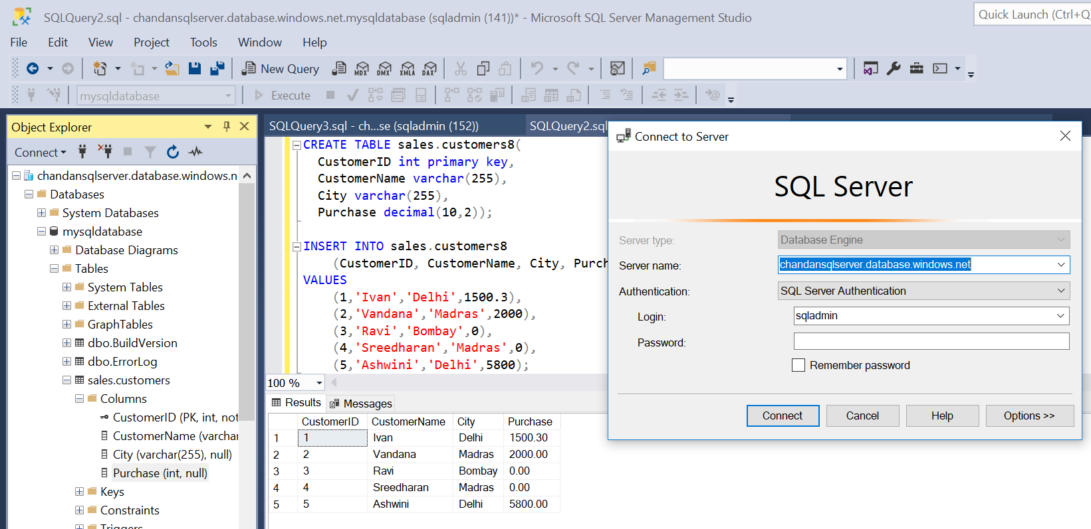
Exercise 2c – Homework SQL DB
Install SQL Server Management Studio at home and try to access the SQL DB with server name, ID and pwd

Slide 9
Wind up
Go to resource group and delete all resource groups.
Leaving any of the service running will incur cost and use up your Azure credit

Slide 10
Day 2 ADF and Pipeline
Introduction to Azure Data Factory
Create azure pipeline
Explain Linked services
Explain Integration run times
Automating jobs in ADF – trigger pipeline
Explain Register events
(Subscriptions >> Resource providers >>Microsoft.EventGrid )
Pre-requisites:
Blob storage
SQL DB and Server
ADF
Books.csv file
Notes:
SSMS - SQL Server Management Studio to interact with SQL Server database Azure Storage Explorer - Tool to interact with Azure storage accounts
https://docs.microsoft.com/en-us/azure/data-factory/
https://docs.microsoft.com/en-us/azure/data-factory/continuous-integration-deployment
Steps for associating an event with a trigger in ADF. To attached an event with trigger 1. Register the Microsoft.EventGrid resource provider with your subscription 2. Go to datafactory pipeline, select the add trigger, new/edit option should be selected 3. Define a name for the trigger 4. Choose the appropriate event object 5. Associate with the relevant resource
https://github.com/MicrosoftLearning/databricks-intro

Slide 11
Exercise 1a – Set Up Azure Data Factory
Create ADF
Click All services >> Analytics >> Data Factory >> Click Add
Create a resource group >> select location as south east asia >> Uncheck Enable Git >> Click create
Generate Service Principal ID
Click on Azure Active directory >> App registration>>New Registration
Give it a name yournameadfapp >> In redirect URL type https://localhost/yournameadfapp >> Click register
In Manage window click certificates and secrets >> click on new client secret >>give it a name >>click add
Copy VALUE and save for later use – This is your SP Key
Click on overview >> Copy Application (client) ID and save for later use – This is your SPID
Add SPID to Blob Storage
Go to your storage account >>click Access control (IAM)>>Add a role assignment
In Role Type contribute >> In select type the name of your registered app yournameadfapp >> select and save
In Role Type reader >> In select type yournameadfapp >> select and save
In Role Type Storage Blob Data Contributor >> In select type yournameadfapp >> select and save
In Role Type Storage Blob Data Reader >> In select type yournameadfapp >> select and save
Check all the roles have been assigned in Role Assignments option

Slide 12
Exercise 1b – Create Pipeline Azure Data Factory
In all resources click on your factory >> Click Author and Monitor
Click copy data >> Give the task name
Source
Click on Create new connection>> Type blob and select
Give connection a Name >> let the integration run time remain default
In Authentication Method select Service Principal >>Select your subscription >>select storage account name
In Service Principal ID paste your SPID >> in service principal key paste your SP Key
Click on test connection >> if successful, click finish
Click Next >> browse Books.csv file (upload the file in blob storage again) >> click next
Review the options >> make sure Column names in the first row is ticked
Click on schema and change the data type of BookID to int32 and Price to double
Destination
Again Click on Create new connection>> Type sql database and select
Give connection a Name >> select server name >> select your database name
Type your SQL User ID and Password and click test connection >> Finish
Select destination table Books.Mybooks (Go to SQL DB and create a table structure as per Books.csv – Day1)
Review the mappings and click next >> Leave settings as is and click next >> click next >> Finish
Check in your SQL DB if data is appearing the Books.Mybooks table

Slide 13
Exercise 1c – Trigger Pipeline Azure Data Factory
Open your SQL DB and delete Books.MyBooks table
Open you Blob storage account and delete the file Books.csv
Go to Author tab in ADF and Open the pipeline that you had created earlier >> click on trigger >> Click on New
From drop down select new >> Give trigger a name >> select event >> select storage account name
Select container name >> write books.csv in blob path begins with and in blob path ends with (explain other options)
Select event blob created >> click on data preview >> click next >> click finish
Open you Blob storage account and upload the file Books.csv
Open your ADF monitor tab and select trigger runs >> you should be able to see your trigger run here
If trigger is successful Open SQL DB and see the data in Books.Mybooks table

Slide 14
Wind up
Go to resource group and delete all resource groups.
Leaving any of the service running will incur cost and use up your Azure credit

Slide 15
Day 3 ML Studio
Machine Learning flow
ML Studio workspace
Running experiments in ML Studio
Create a web service from Experiment
Test and Consume web service

Slide 16
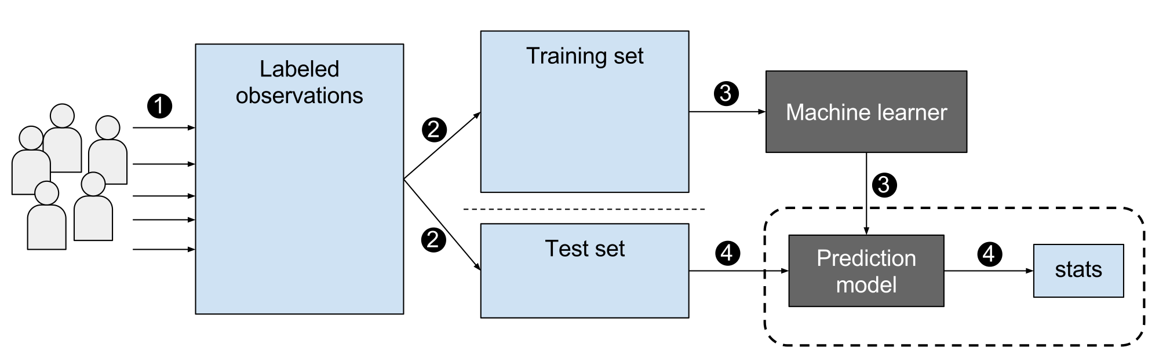
Machine Learning Flow ML Studio

Slide 17
Exercise 1a ML Studio
Set up
Click All services >> AI + Machine Learning >> Machine Learning Studio Work space
Give workspace a name >> Select existing resource group >> Location southeast asia
Storage account create new >> Web service plan create new >> Web service plan pricing tier >> Dev Test
Click on workspace name >> Launch Machine learning studio >> Sign in with your outlook account
Experiment Click on experiment tab >> Click on New >> Blank experiment
Search for Automobile price data >> drag and drop >> run experiment and visualize data
Type select columns in dataset >> draft and drop >> connect the box >> select all columns except normalized-losses
Again select columns in dataset >> draft and drop >> connect the box >> take columns [engine-size,horsepower,make,body-style,peak-rpm,highway-mpg,price,wheel-base]
Search Split Data >> drag and drop >> connect the box >> Select fraction as .75 and random seed as 5
Search Train model >> drag and drop >> connect node 1 of split with second dot in train model
Search Linear Regression >> drag and drop >> connect node 1 with first dot in train model
Search score model >> drag and drop >> connect node of train data with first dot in score model
connect node 2 of split data with second dot in score model
Search evaluate model >> drag and drop >> connect node of score box with dot in evaluate model
Click on Run >> right click the output note of evaluate model and select visualize to see prediction

Slide 18
Exercise 1b ML Studio
Web Service
Rename the last experiment to Regression experiment
Click on Set up web service
Run the service to validate once
Click on Deploy web service >> click test >> Input all the values and see the results
Create a new experiment with MPG data for various automobiles. Try using multiple models to see which one gives better result
Import an external data and run a prediction model

Slide 19
Assignment
Complete all remaining Data Lake Lab examples from here: https://github.com/JAkerblom/MicrosoftDataSciProgram/tree/master/Azure%20Data%20Lake%20(DAT223.1x)
Complete Azure Fundamentals: https://docs.microsoft.com/en-us/learn/paths/azure-fundamentals/
Complete AI For Everyone: https://www.coursera.org/learn/ai-for-everyone
Create an event trigger that will transfer the data from Azure blob to an SQL DB as soon as blob is crated
Using any data create an experiment in Azure ML Studio and publish it as web service. Share the link with your team mates to consume the service and let you give the feedback on model’s performance

